Slide 1
Proposal of Website Design
TOURISM: AN INTERACTIVE AND INFORMATIVE WEBSITE

Slide 2
1.
Place Introduction: PETALING STREET (Chinatown Kuala Lumpur)

Slide 3
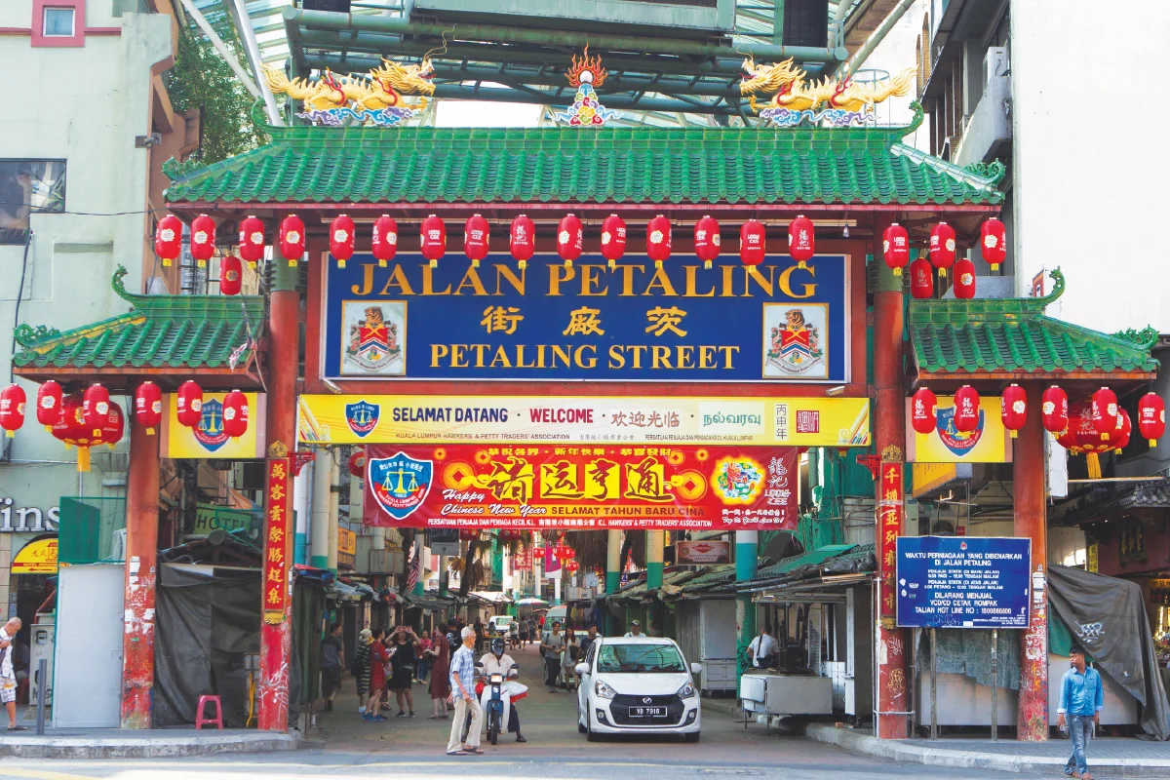
Place Introduction: Chinatown Kuala Lumpur
Petaling Street is the Chinatown of Kuala Lumpur.
Visitors come to Petaling Street to either dine on the famous street foods here or to get some good bargains on things sold here.

Slide 4
Target User
Tourists
The area surrounds the Petaling Street is one of the most popular tourist destinations
Low currency for RM attract a lot of tourists come for a trip
The Locals
Malaysians love to travel around, especially in holidays and weekends
Bringing family, friends and colleagues

Slide 5
Project Concept and Plan

Slide 6
Main Page
https://www.figma.com/file/qT5BGCoQvvPbEvGKnW4bRy/Untitled?node-id=0%3A1

Slide 7
Sub-Pages
FOODS & BEVERAGES
https://www.figma.com/file/qT5BGCoQvvPbEvGKnW4bRy/Untitled?node-id=18%3A2
TOURIST ATTRACTION:
https://www.figma.com/file/qT5BGCoQvvPbEvGKnW4bRy/Untitled?node-id=19%3A5
INTERESTING IN NIGHTLIFE SPOTS:
https://www.figma.com/file/T7HRNk9AcCxlUotZOVQ4E1/Untitled?node-id=0%3A1
GETTING HERE:
https://www.figma.com/file/T7HRNk9AcCxlUotZOVQ4E1/Untitled?node-id=2%3A22

Slide 8
Project Reference for Functionality and Design
https://mypenang.gov.my/home/?lg=en
https://www.melaka-tourism.com/

Slide 9
Thanks!

